Slide 1
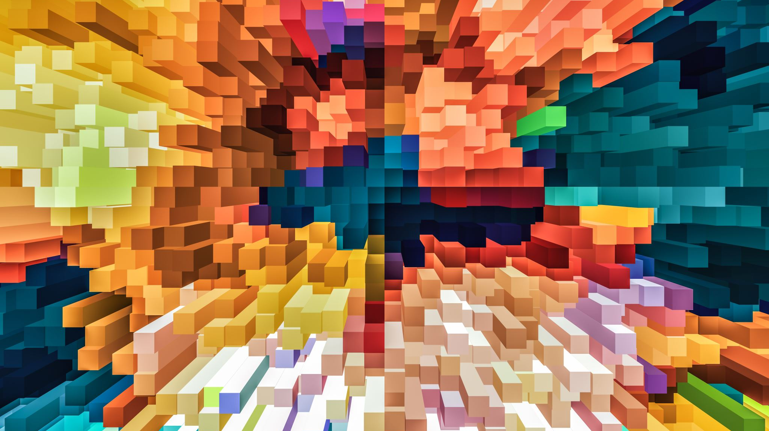
Progress Pitch
Week 8

Slide 2
Last papers
Fast, Parallel, GPU-based Construction of Space Filling Curves and Octrees
High Resolution Sparse Voxel DAGs
SSVDAGs: Symmetry-aware Sparse Voxel DAGs
Efficient Animation of Sparse Voxel Octrees for Real-Time Ray Tracing

Slide 3
Papers this time
Conservative voxelization
GigaVoxels : Ray-Guided Streaming for Efficient and Detailed Voxel Rendering
Real-time Voxelization for Complex Models
Octree-Based Sparse Voxelization Using the GPU Hardware Rasterizer
Interactive Indirect Illumination Using Voxel Cone Tracing
An Approach to Global Illumination Calculation Based on Hybrid Cone Tracing

Slide 4
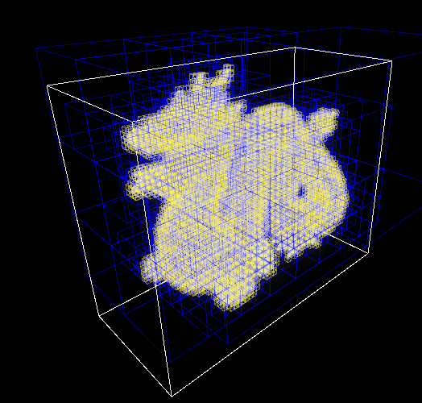
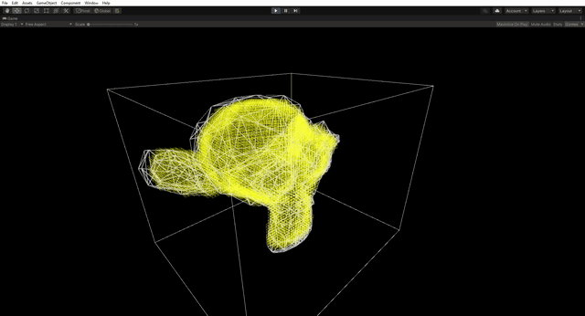
GPU SVO voxelization

Slide 5
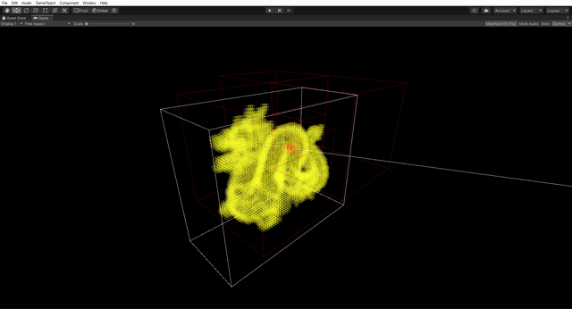
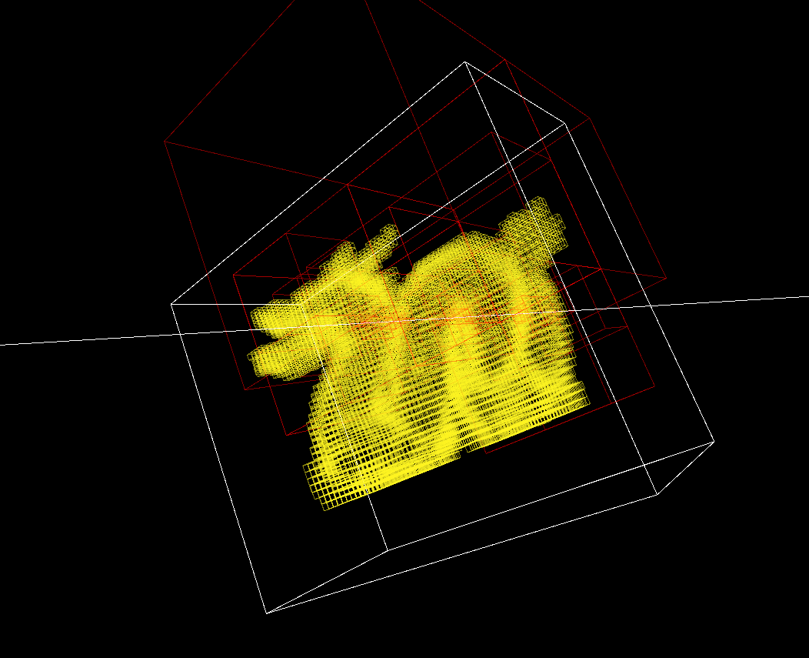
Octree animation for ray casting/tracing

